Slide 1
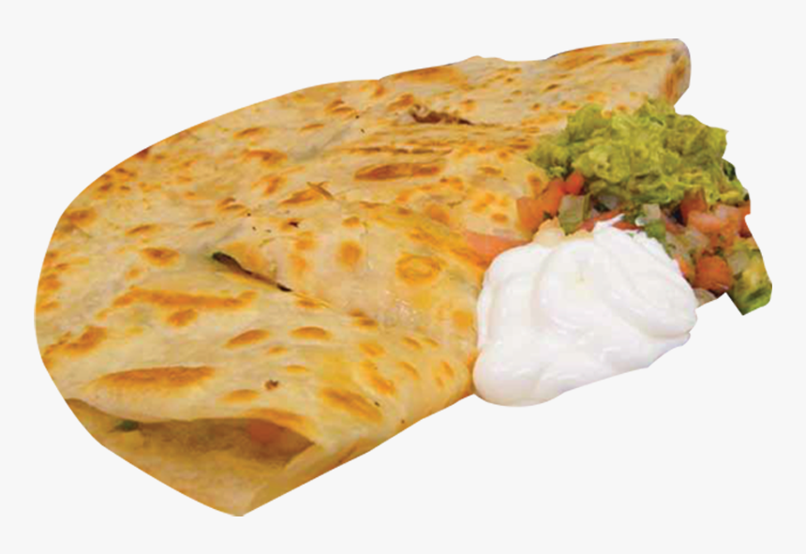
Smart Kitchen Robot for Automatic Stuffing & Making of Famous Indian Bread Variety
Dhinesh R, Guruchandran S, Jeevan Sidharth G, Shruthi K, Naveen Prakash R

Slide 2
Contents
Background
Objective
Prototype Diagram
How it works ?
Key Components
Conclusion

Slide 3
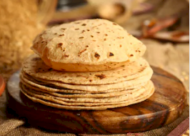
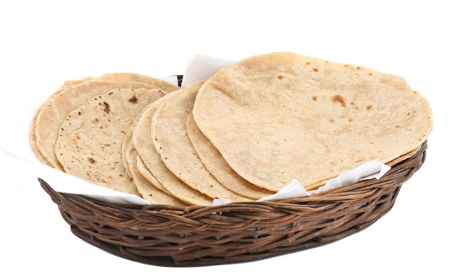
1. Background
Chapatis are an integral part of Indian cuisine and diet. On average around 10 chapatis are made for a meal for a family of 3 and making chapatis especially the dough-making process is a tedious process and time-consuming.
Stuffed chapatis like aloo parathas would be even more time-consuming.
There isn’t a machine like a microwave oven for making chapatis that is completely automatic and compact to fit in modern kitchens.
According to statistics approximately 803.52 crore chapati are eaten in India in a single day.

Slide 4
2. Objective
To develop a robotic device which would completely automate stuffed chapati making process starting from dough kneading to storing the chapatis.
The dough balls are flattened and baked in the baking machine using heating coils and dispensed into a detachable hot box for storing and maintaining the chapatis hot & fresh to be served later.
*
*
*
Wheat flour & water are dispensed from 2 separate removable containers into a kneading jar. The dough is kneaded and dispensed into a encrusting machine.
Stuffing material is directly delivered to the encrusting machine and stuffed dough balls are obtained after passing through screw feeder and servo cutter.

Slide 5
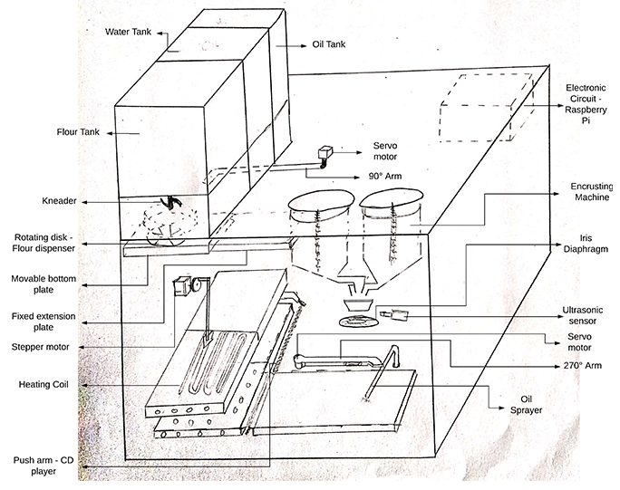
3. Prototype Diagram
Blueprint

Slide 6
4. How it works ?
Proposed Idea
The proposed device consists of 4 sections namely: 3 Vessel Diagram, Encrusting Machine, Baking Machine and Hot Box.
The flour is dispensed using a rotating disk mechanism into the kneading jar and water is delivered using a DC pump. The dough is kneaded and dispensed into the encrusting machine using the 90° servo arm.
The screw feeder squeezes the content through the depositing nozzle like a syringe injection. The stuffing material and dough ball are mixed and squeezed through the output nozzle.
The iris diaphragm or a servo cutter cuts the dough into spherical shape and is dropped on the baking machine.
Required oil amount is sprayed on the dough ball and then moved using a 270 ° servo arm where it is flattened and baked using heating coils.
Hot & Fresh chapatis are dispensed into the detachable hot box where it is kept warm and stored for serving later. The mobile app developed is used for remote control of this device where no of chapatis required, its thickness and oil levels can be entered and hot & fresh chapatis would be made and stored in the hot box.

Slide 7
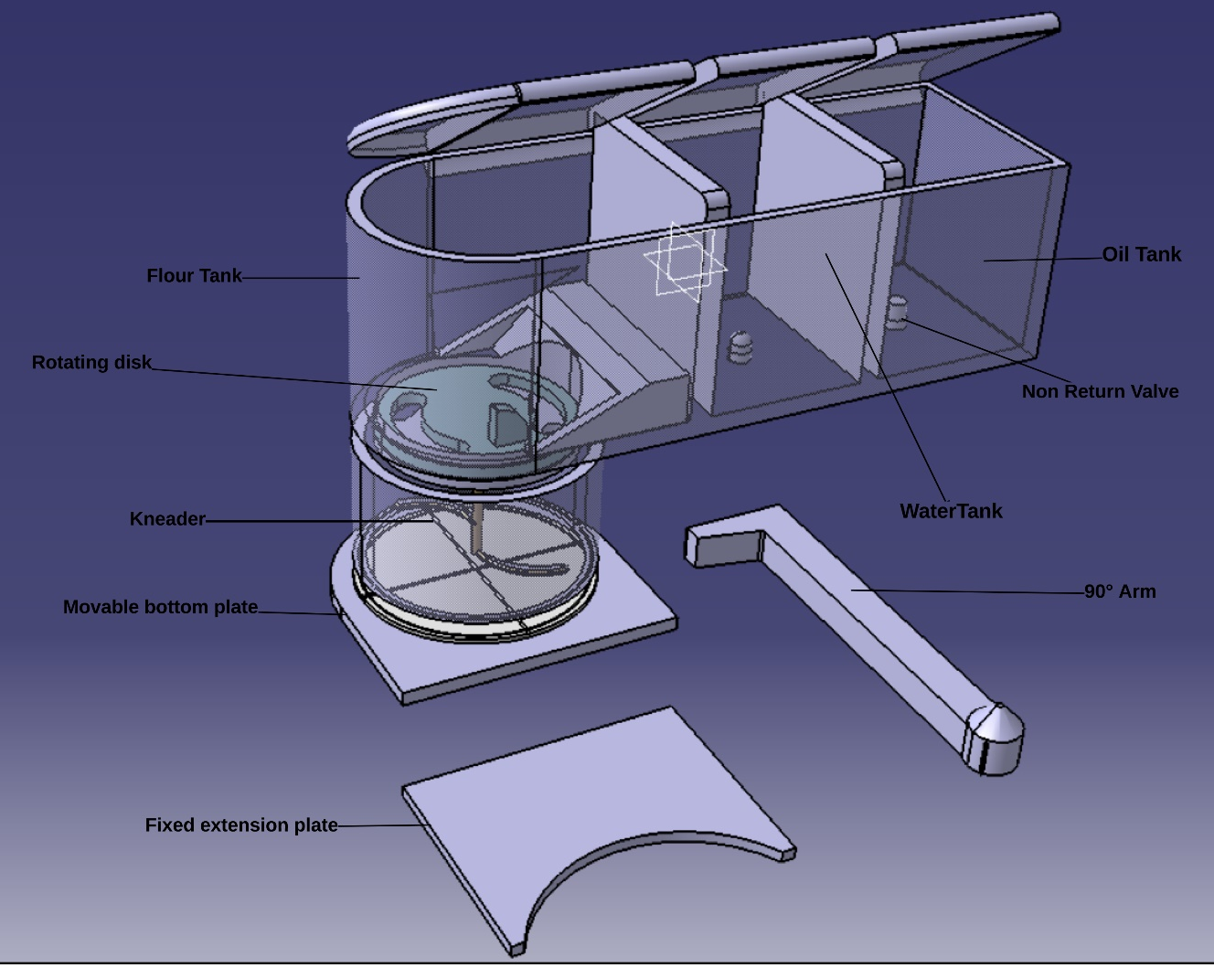
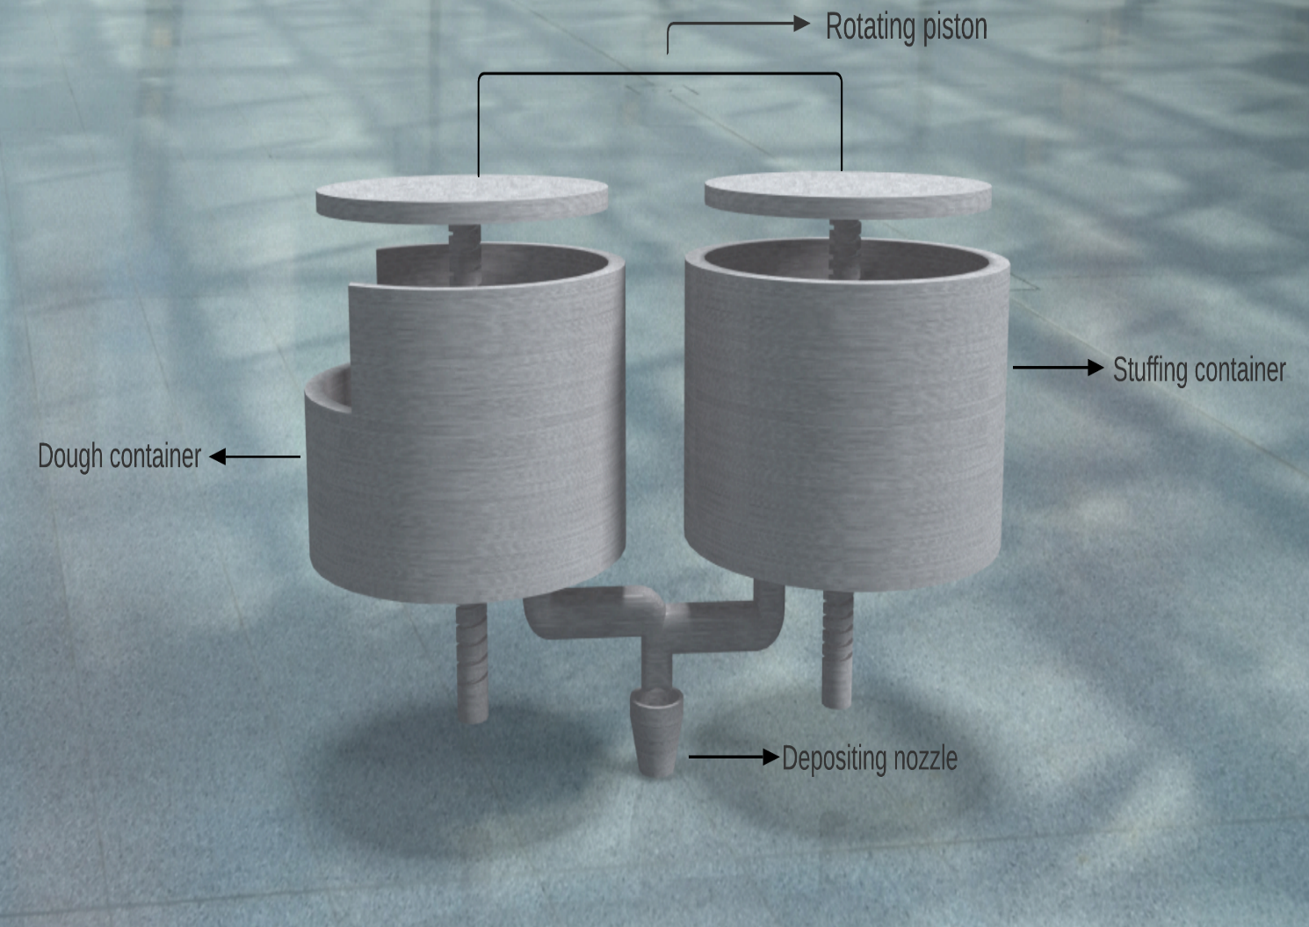
5. Key Components
3 Vessel Diagram
Encrusting Machine

Slide 8
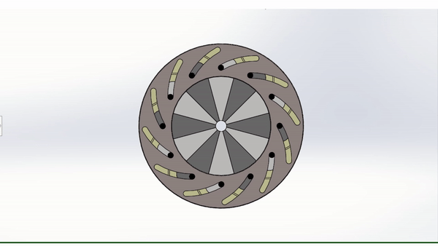
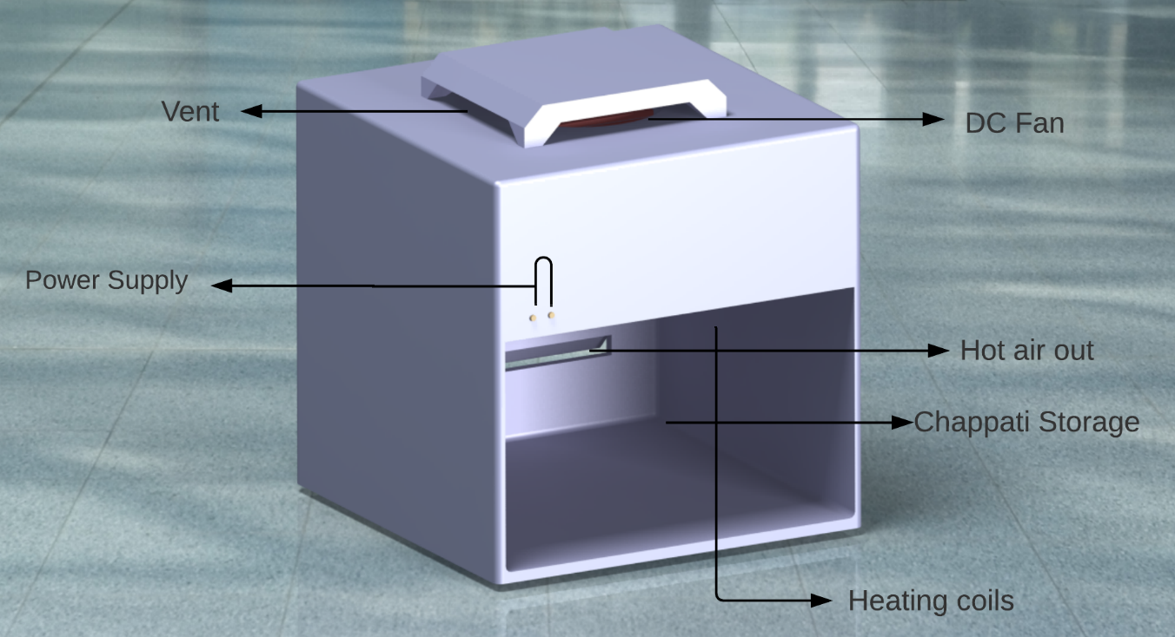
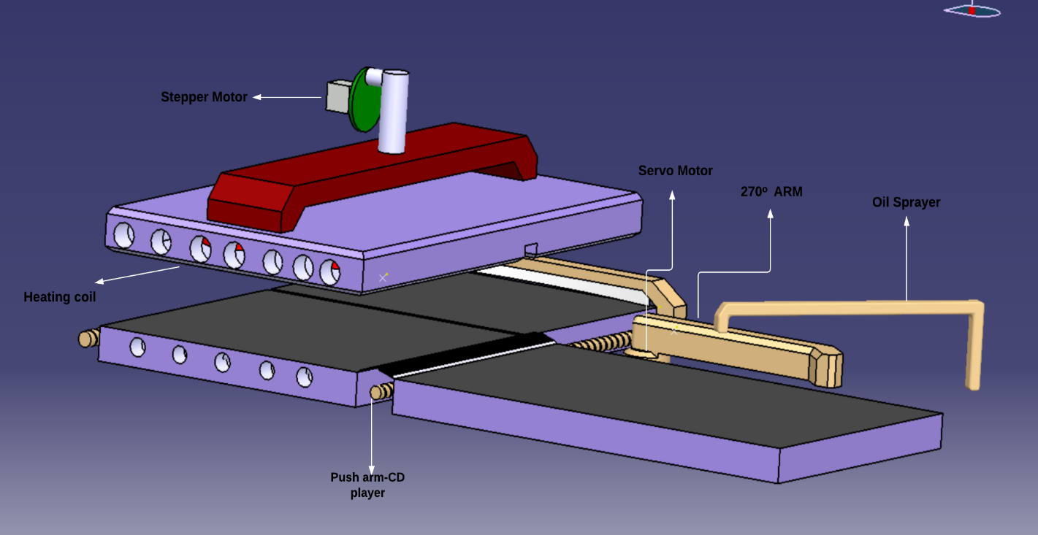
5. Key Components
Iris Diaphragm
Hot Box
Baking Machine

Slide 9

6. Conclusion
A fully automatic stuffed chapati making machine is designed which would be the size of a microwave oven and could blend well in modern kitchens priced at around 10K to 15K INR.
It is aimed at reducing burden of making a food item which is almost made every day in Indian households.
Smart IOT features benefits office goers for remote control of the device.
Provision for making stuffed chapatis like aloo parathas.
Remote Control

Slide 10
Thank You

